Slide 1
أكـــــاديميــــة طــــويـــق
Artificial Intelligence Ethics

Slide 2
Foundations of AI Ethics
By: Dr. Afshan Hashmi

Slide 3
Course Objectives:
Introduce ethical principles and their role in AI and data science. Differentiate between ethical and legal considerations in AI.
Course Learning Outcomes:
Understand the importance of ethics in responsible AI development.
Identify key ethical challenges, including bias and accountability.

Slide 4
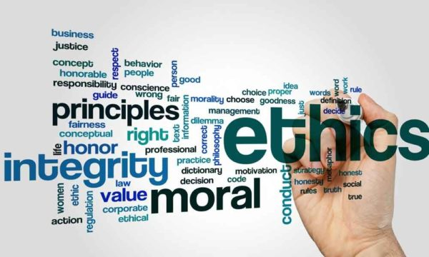
Introduction to Ethics in AI
Ethics in AI refers to the principles and guidelines that ensure artificial intelligence systems are developed and used responsibly, fairly, and safely.
As AI becomes more integrated into various aspects of society, ethical considerations help prevent biases, discrimination, privacy violations, and other unintended consequences.

Slide 5

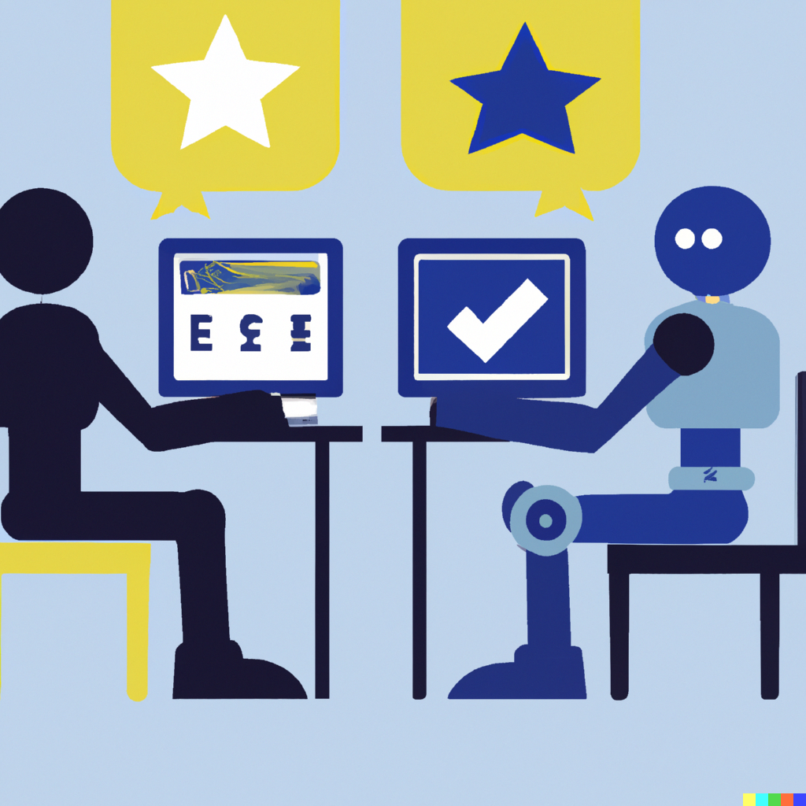
Definition and Importance of Ethics in AI and Data Science
Definition: AI ethics involves moral principles guiding the design, development, and deployment of AI systems to ensure fairness, transparency, accountability, and inclusivity.
Importance:
Prevents biases and discrimination in AI models.
Ensures user privacy and data security.
Promotes transparency and accountability in decision-making.
Builds trust among users, businesses, and governments.
This Photo by Unknown Author is licensed under CC BY

Slide 6
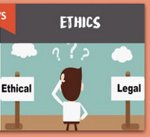
Ethical Considerations in AI Development
Ethical Considerations: Moral guidelines that determine what is right or wrong in AI usage, even if there are no laws governing them.
Examples:
Should AI systems make decisions that impact human lives (e.g., autonomous vehicles, healthcare diagnostics)?
How can we ensure AI respects human dignity and fairness?

Slide 7
Legal Considerations in AI Development
Legal Considerations: Regulations and laws that govern AI usage to protect individuals and organizations. Examples:
GDPR (General Data Protection Regulation) for data privacy in AI.
Laws against AI-driven discrimination in hiring or lending.
Compliance with copyright and intellectual property laws in AI-generated content.

Slide 8
The Role of Ethics in Responsible AI and Data-Driven Decision-Making
Ethical AI ensures that machine learning models and data-driven decisions align with human values.
Fairness & Bias Reduction: Ensuring AI does not favor one group over another.
Transparency & Explainability: Making AI decisions understandable to users.
Accountability: Holding AI developers and organizations responsible for AI-driven decisions.
Privacy & Security: Protecting user data and ensuring informed consent.
By integrating ethics into AI development, we can create systems that benefit society while minimizing harm and misuse.

Slide 9
Moral Responsibility and AI Development
Who is Responsible for AI Decisions? Developers, Organizations, or Users?
AI systems do not operate independently; they are created, trained, and deployed by humans. Therefore, responsibility for AI decisions can be divided among:
Developers:
Responsible for designing ethical algorithms and ensuring data fairness.
Must mitigate biases and ensure transparency in AI models.
Organizations:
Should establish ethical AI policies and governance frameworks.
Need to ensure AI is used responsibly in real-world applications.
Users:
Need awareness of AI limitations and potential biases.
Must use AI responsibly and understand its ethical implications.
Since AI lacks moral reasoning, responsibility ultimately lies with human stakeholders, including policymakers and regulators.

Slide 10
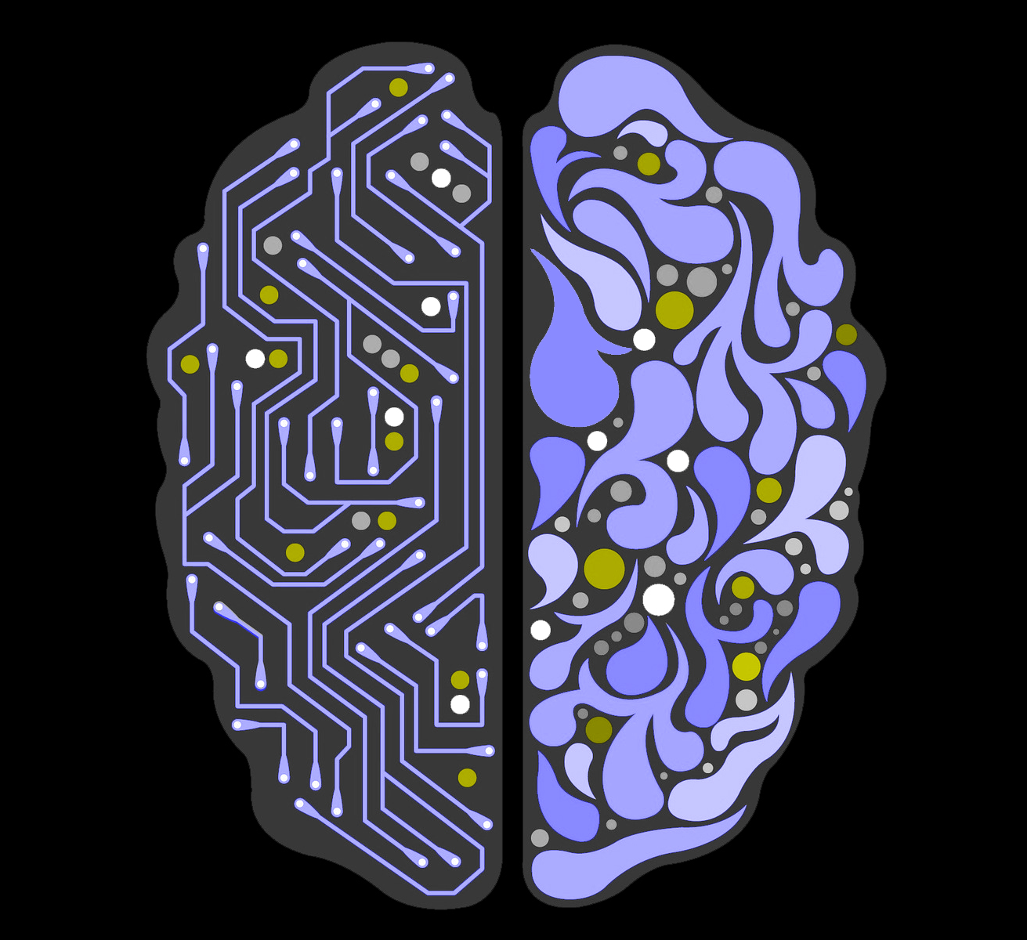
The Ethics of AI Autonomy and Decision-Making
AI systems can make decisions without direct human intervention, raising ethical concerns.
Key ethical issues:
Accountability: If an autonomous AI makes a harmful decision (e.g., an accident caused by a self-driving car), who is responsible?
Transparency: Can AI decisions be explained and understood?
Fairness: Does AI treat all individuals equally, without bias?
Control: Should AI have full autonomy in critical areas like criminal justice, hiring, or healthcare?

Slide 11
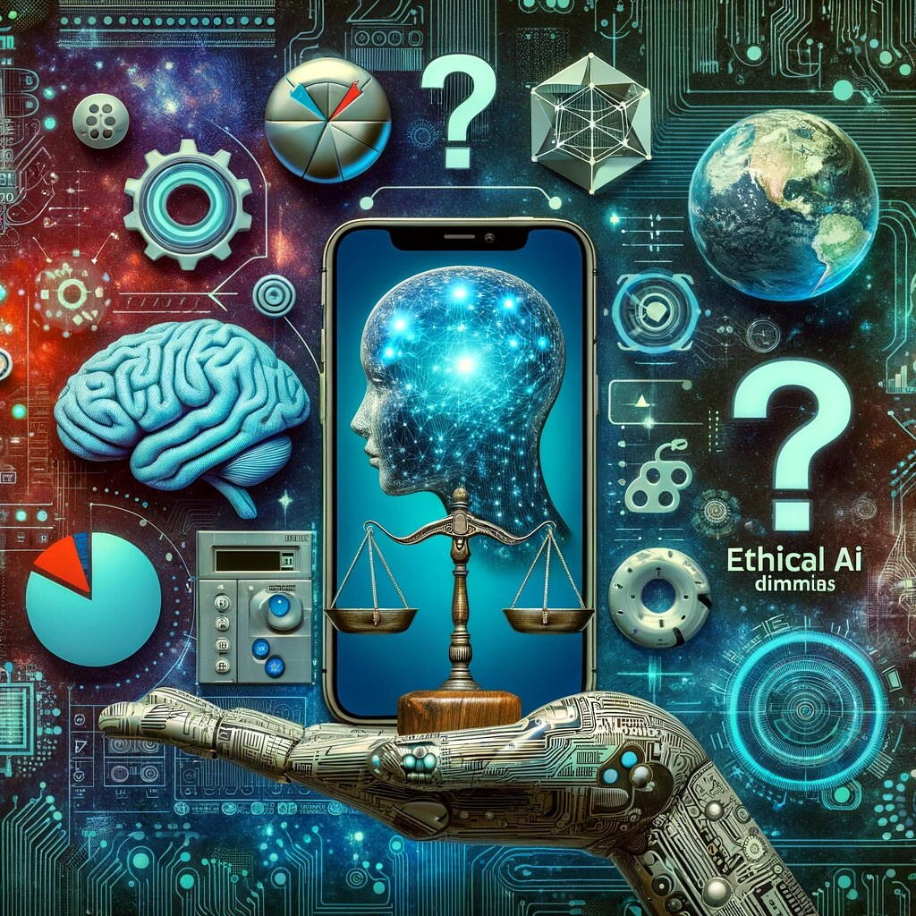
Ethical Considerations in AI for Social Good
AI can be used to solve societal challenges, but ethical issues must be addressed:
Healthcare AI: Improves diagnostics but must ensure patient privacy and avoid bias.
Education AI: Enhances learning but should not reinforce inequalities.
AI in Humanitarian Aid: Helps in disaster response, but must avoid misuse of sensitive data.

Slide 12
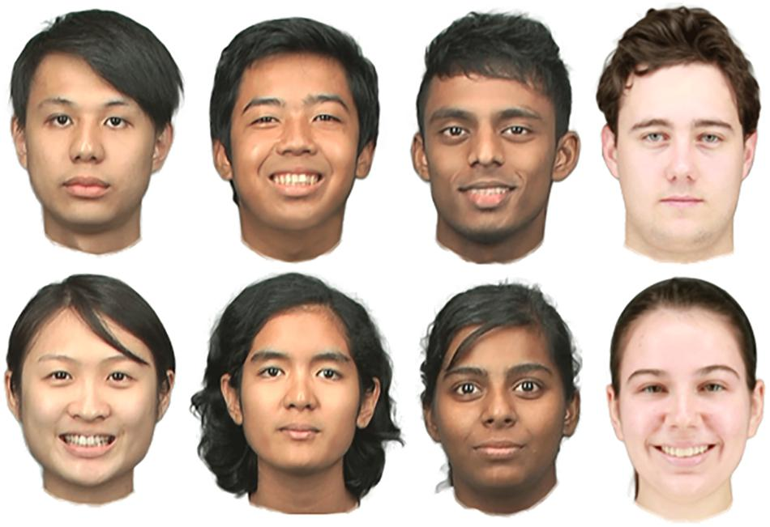
Case Studies on AI Ethics Violations
AI in Predictive Policing: Racial Bias in Algorithms
Some AI models used for predicting crime (e.g., COMPAS) have been found to unfairly target minority communities.
Bias in training data leads to racial profiling and discrimination.
Ethical concern: Reinforcing systemic biases and unfair law enforcement practices.
(Correctional Offender Management Profiling for Alternative Sanctions) is a risk assessment algorithm used in the U.S. criminal justice system to predict the likelihood of a defendant reoffending (recidivism). It helps judges make decisions on bail, sentencing, and parole.

Slide 13

Case Studies on AI Ethics Violations
2. Ethical Concerns in Facial Recognition Technology
Facial recognition systems (e.g., Clearview AI) have been criticized for violating privacy.
Studies show these systems often misidentify minorities at higher rates.
Ethical concern: Mass surveillance, privacy invasion, and racial bias.

Slide 14
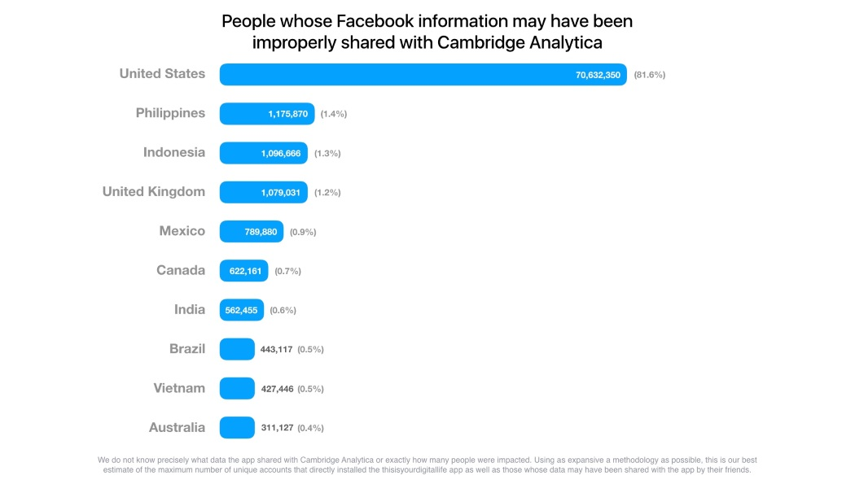
Case Studies on AI Ethics Violations
3. The Cambridge Analytica Scandal: Data Misuse and Privacy Breaches
In 2018, Cambridge Analytica improperly harvested Facebook user data to influence elections.
It raised concerns about data privacy and manipulation in political campaigns.
Ethical concern: Lack of user consent, exploitation of personal data, and political interference.

Slide 15
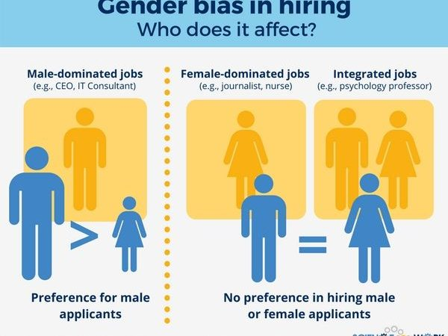
Case Studies on AI Ethics Violations
4. Bias in Hiring Algorithms: Case Studies from Industry
AI-driven hiring tools (e.g., Amazon’s hiring algorithm) showed bias against women due to past hiring data.
AI learned historical biases and discriminated against female applicants.
Ethical concern: Unfair hiring practices and discrimination.

Slide 16
RECAP
Ethics in AI ensures fairness, transparency, and accountability in decision-making.
AI ethics go beyond legal compliance to address moral responsibilities.
Developers, organizations, and users share responsibility for AI decisions.
AI autonomy raises concerns about accountability and unintended biases.
Ethical AI can drive social good but must avoid discrimination and misuse.
Case studies highlight issues like bias in predictive policing and hiring algorithms.
The Cambridge Analytica scandal exposed data misuse and privacy violations.
Responsible AI development requires transparency, fairness, and ethical guidelines.

Slide 17

















الشراكات العالمية

Slide 18
شــــــكــــرًا لكــــــم
THANK YOU

